Slide 1
Memory Management Techniques

Slide 2
Memory Management Techniques
Memory Management Techniques
Contiguous
Fixed Partition
Variable Partition
Non-Contiguous
Paging
Multi level Paging
Inverted Paging
Segmnetation
Segmented Paging
Static
Dynamic

Slide 3
Contiguous memory allocation

Slide 4
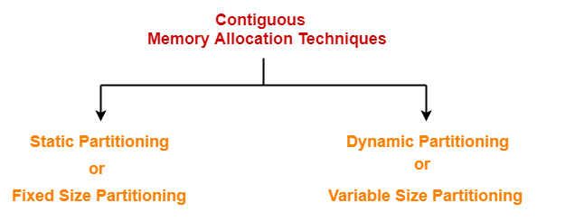
Contiguous Memory Allocation
Contiguous memory allocation is a memory allocation technique.
It allows to store the process only in a contiguous fashion.
Thus, entire process has to be stored as a single entity at one place inside the memory.
Techniques-
There are two popular techniques used for contiguous memory allocation-

Slide 5
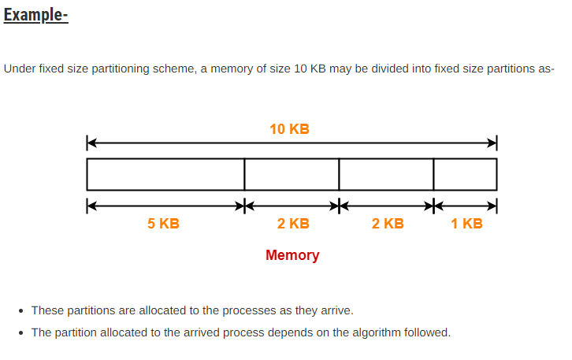
Static Partitioning
Static partitioning is a fixed size partitioning scheme.
In this technique, main memory is pre-divided into fixed size partitions.
The size of each partition is fixed and can not be changed.
Each partition is allowed to store only one process.
The earliest and one of the simplest technique which can be used to load more than one processes into the main memory

Slide 6
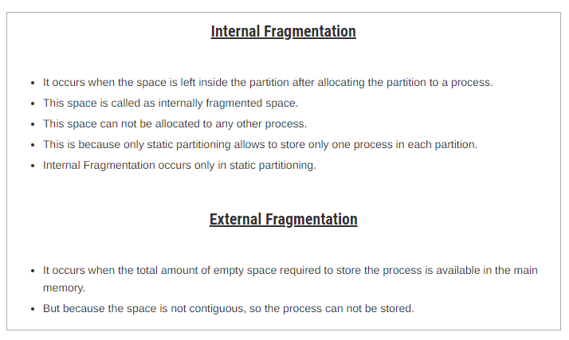

Slide 7
Partitioning Algorithms

Slide 8
Partitioning Algorithms
For both fixed and dynamic memory allocation schemes, the operating system must keep list of each memory location noting which are free and which are busy. Then as new jobs come into the system, the free partitions must be allocated. These are Contiguous memory allocation techniques.These partitions may be allocated by 4 ways:
First-Fit Memory Allocation
Best-Fit Memory Allocation
Worst-Fit Memory Allocation
Next-Fit Memory Allocation

Slide 9
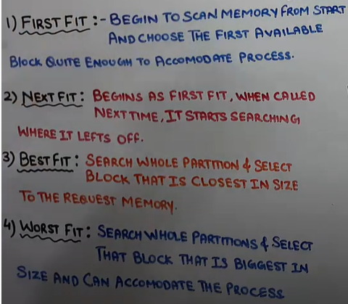
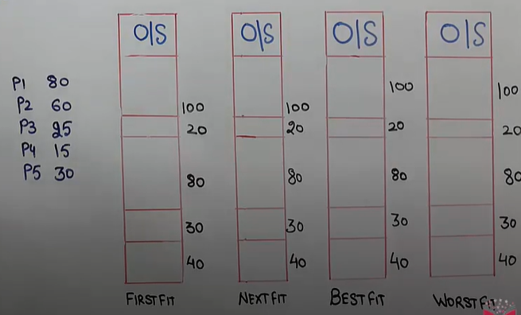

Slide 10
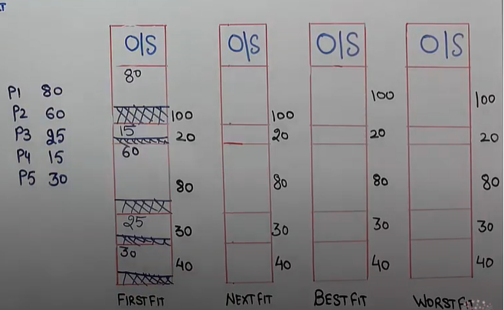
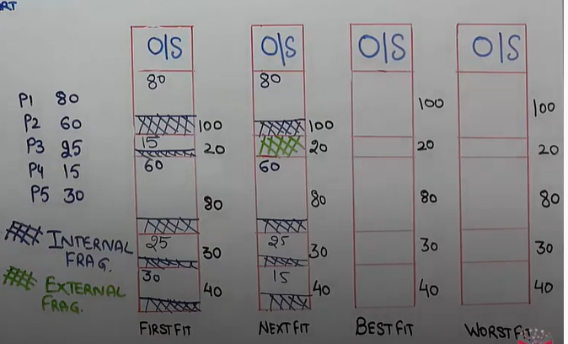

Slide 11
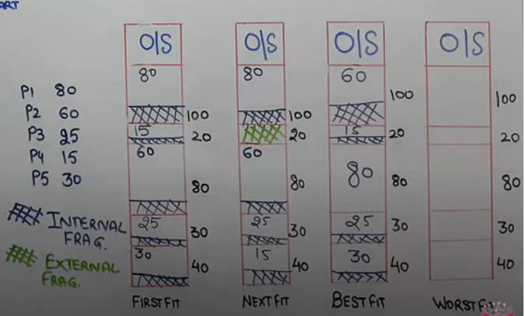
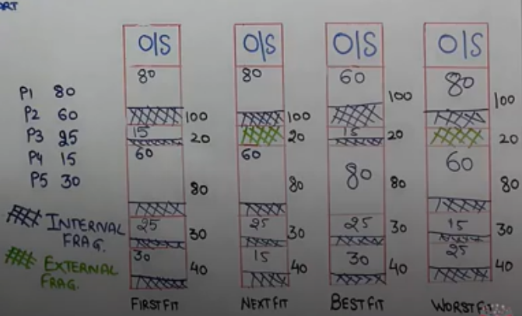

Slide 12
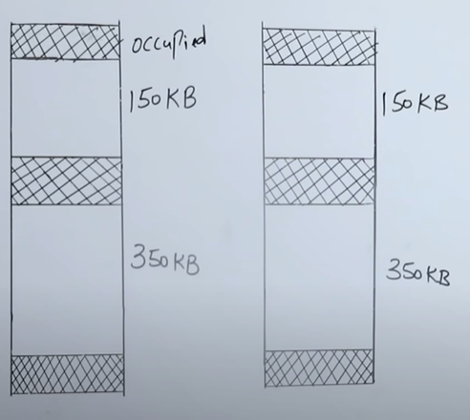
Numerical
Request from processes are 300k, 25k,125k,50k.Determine the algorithm which can optimally satisfy this requirement.
First Fit algorithm
Best Fit Algorithm
Neither of the two
Both of them

Slide 13
First Fit algorithm
Request from processes are 300k, 25k,125k,50k.Determine the algorithm which can optimally satisfy this requirement.
First Fit algorithm
Best Fit Algorithm
Neither of the two
Both of them
P1=300k
P2=25k
P3=125k
P4=50k
P1

Slide 14
First Fit algorithm
Request from processes are 300k, 25k,125k,50k.Determine the algorithm which can optimally satisfy this requirement.
First Fit algorithm
Best Fit Algorithm
Neither of the two
Both of them
P1=300k
P2=25k
P3=125k
P4=50k
P2
P1

Slide 15
First Fit algorithm
Request from processes are 300k, 25k,125k,50k.Determine the algorithm which can optimally satisfy this requirement.
First Fit algorithm
Best Fit Algorithm
Neither of the two
Both of them
P1=300k
P2=25k
P3=125k
P4=50k
P2
P3
P1

Slide 16
First Fit algorithm
Request from processes are 300k, 25k,125k,50k.Determine the algorithm which can optimally satisfy this requirement.
First Fit algorithm
Best Fit Algorithm
Neither of the two
Both of them
P1=300k
P2=25k
P3=125k
P4=50k
P2
P3
P1
P4

Slide 17
Best Fit Algorithm
Request from processes are 300k, 25k,125k,50k.Determine the algorithm which can optimally satisfy this requirement.
First Fit algorithm
Best Fit Algorithm
Neither of the two
Both of them
P1
P2
P1=300k
P2=25k
P3=125k
P4=50k

Slide 18

Best Fit Algorithm
Request from processes are 300k, 25k,125k,50k.Determine the algorithm which can optimally satisfy this requirement.
First Fit algorithm
Best Fit Algorithm
Neither of the two
Both of them
P3
P1
P2
P1=300k
P2=25k
P3=125k
P4=50k

Slide 19
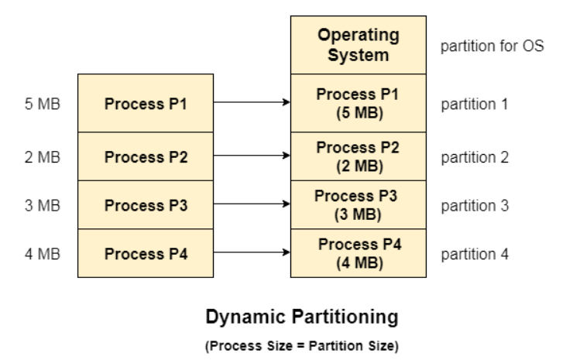
Dynamic partitioning
Dynamic partitioning tries to overcome the problems caused by fixed partitioning. In this technique, the partition size is not declared initially. It is declared at the time of process loading.
The first partition is reserved for the operating system. The remaining space is divided into parts. The size of each partition will be equal to the size of the process. The partition size varies according to the need of the process so that the internal fragmentation can be avoided.
Advantages:
No Internal Fragmentation
No Limitation on the size of the process

Slide 20
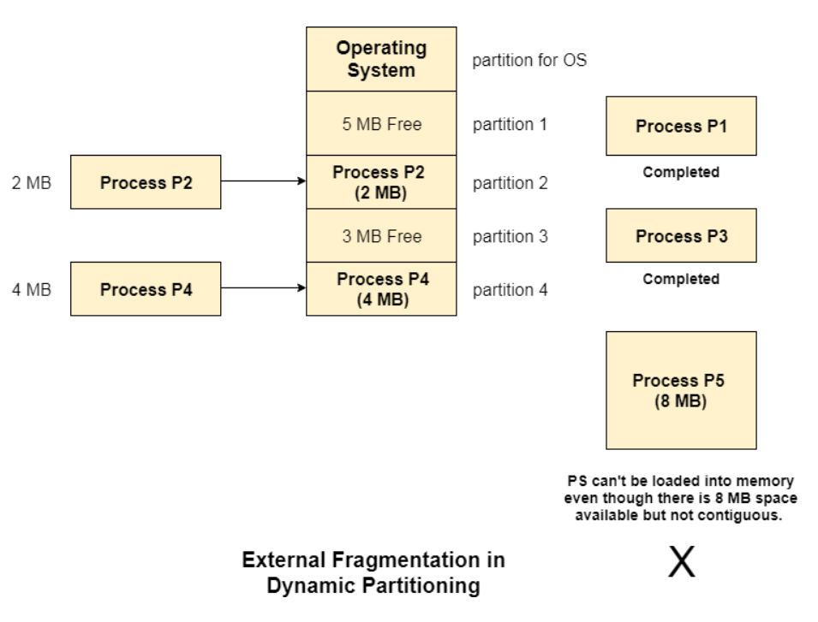
Disadvantage
Let's consider three processes P1 (1 MB) and P2 (3 MB) and P3 (1 MB) are being loaded in the respective partitions of the main memory.
After some time P1 and P3 got completed and their assigned space is freed. Now there are two unused partitions (1 MB and 1 MB) available in the main memory but they cannot be used to load a 2 MB process in the memory since they are not contiguously located.
The rule says that the process must be contiguously present in the main memory to get executed. We need to change this rule to avoid external fragmentation.

Slide 21
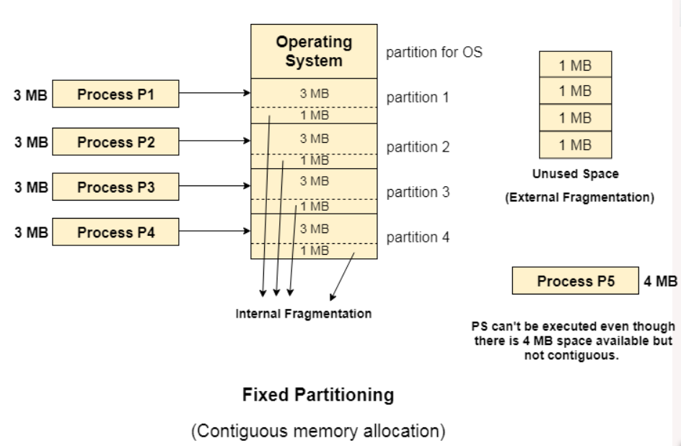
Limitation on the size of the process
If the process size is larger than the size of maximum sized partition then that process cannot be loaded into the memory. Therefore, a limitation can be imposed on the process size that is it cannot be larger than the size of the largest partition.

Slide 22
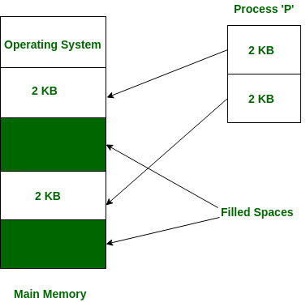
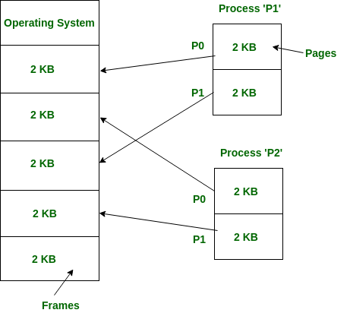
Non-Contiguous memory allocation
Non-Contiguous memory allocation is basically a method on the contrary to contiguous allocation method, allocates the memory space present in different locations to the process as per it’s requirements. As all the available memory space is in a distributed pattern so the freely available memory space is also scattered here and there.
This technique of memory allocation helps to reduce the wastage of memory, which eventually gives rise to Internal and external fragmentation.

Slide 23
NonContiguous memory allocation
Paging

Slide 24
Need of NonContiguous memory allocation
External fragmentation not resolve in Contiguous memory allocation that why we need NonContiguous memory allocation in which we have paging and segmentation

Slide 25
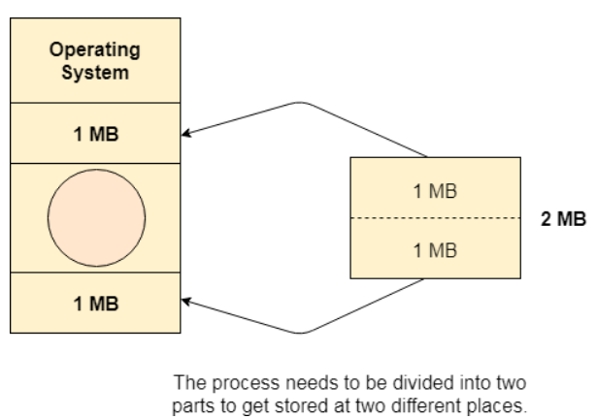
Paging
In paging we divide process into pages and memory into frames.
The Idea behind paging is to divide the process in pages so that, we can store them in the memory at different holes.

Slide 26
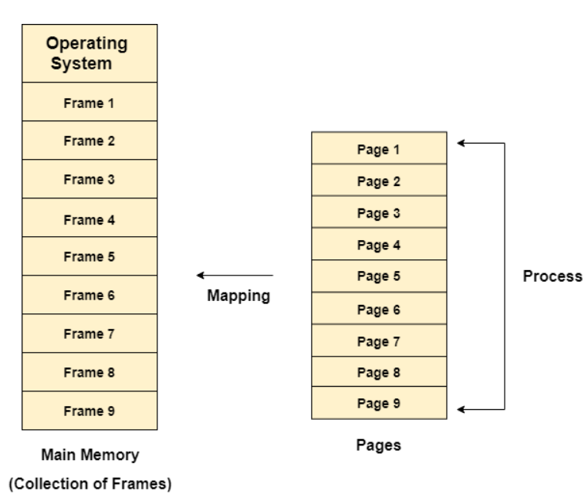
One page of the process is to be stored in one of the frames of the memory. The pages can be stored at the different locations of the memory but the priority is always to find the contiguous frames or holes.

Slide 27
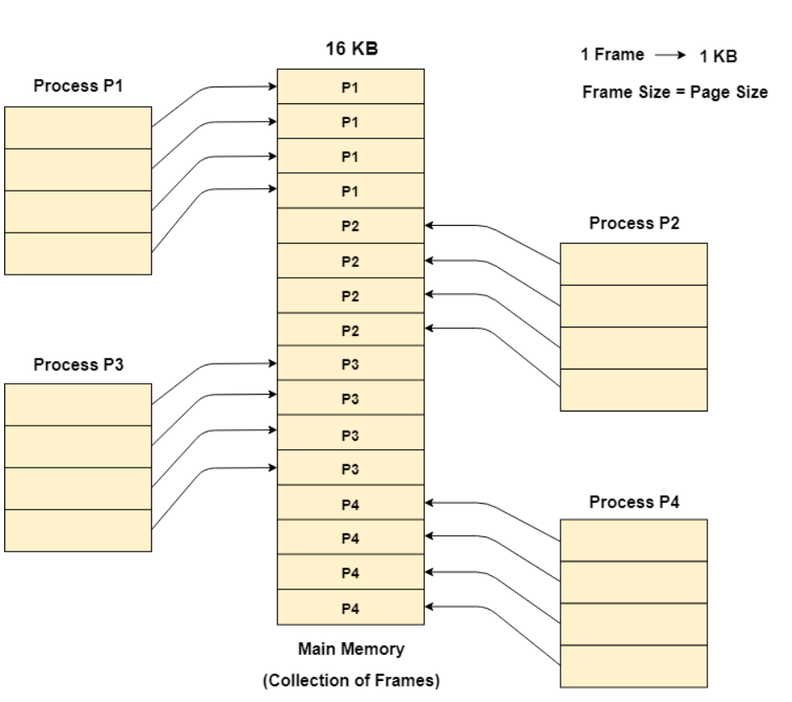
Example
Let us consider the main memory size 16 Kb and Frame size is 1 KB therefore the main memory will be divided into the collection of 16 frames of 1 KB each.
There are 4 processes in the system that is P1, P2, P3 and P4 of 4 KB each. Each process is divided into pages of 1 KB each so that one page can be stored in one frame.
Initially, all the frames are empty therefore pages of the processes will get stored in the contiguous way.
Frames, pages and the mapping between the two is shown in the image below.

Slide 28
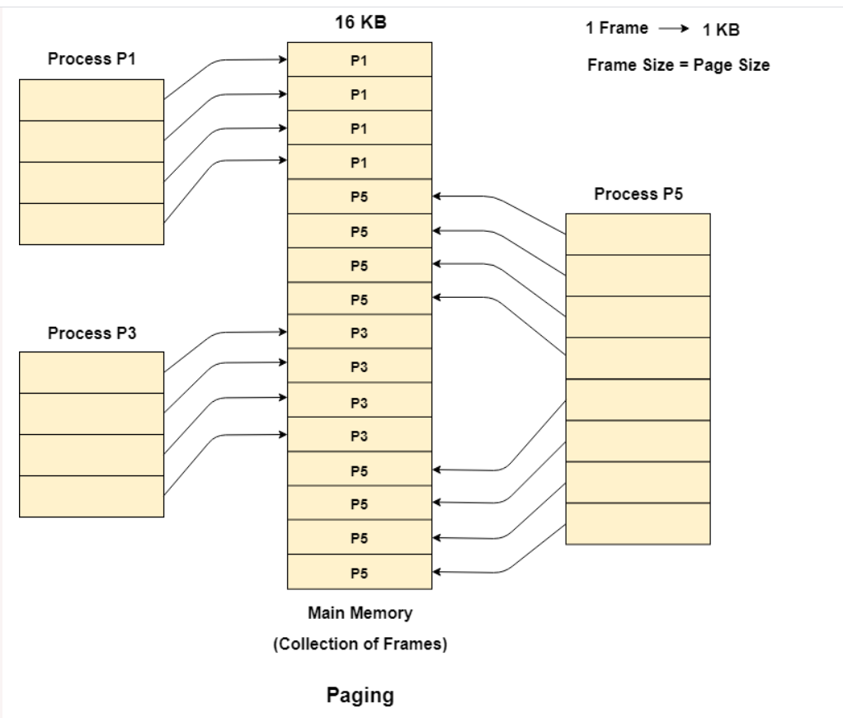
Let us consider that, P2 and P4 are moved to waiting state after some time. Now, 8 frames become empty and therefore other pages can be loaded in that empty place. The process P5 of size 8 KB (8 pages) is waiting inside the ready queue.
Given the fact that, we have 8 non contiguous frames available in the memory and paging provides the flexibility of storing the process at the different places. Therefore, we can load the pages of process P5 in the place of P2 and P4. it eliminates external fragmentation

Slide 29
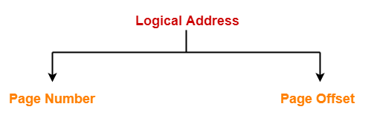
Translating Logical Address into Physical Address-
CPU always generates a logical address.
A physical address is needed to access the main memory.
Following steps are followed to translate logical address into physical address-
Step-01:
CPU generates a logical address consisting of two parts-
Page Number
Page Offset
Page Number specifies the specific page of the process from which CPU wants to read the data.
Page Offset specifies the specific word on the page that CPU wants to read.

Slide 30
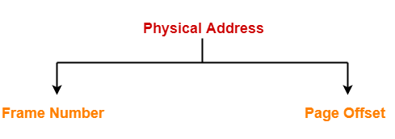
Step-02:
For the page number generated by the CPU,
Page Table provides the corresponding frame number (base address of the frame) where that page is stored in the main memory.
Step-03:
The frame number combined with the page offset forms the required physical address.
Frame number specifies the specific frame where the required page is stored.
Page Offset specifies the specific word that has to be read from that page.

Slide 31
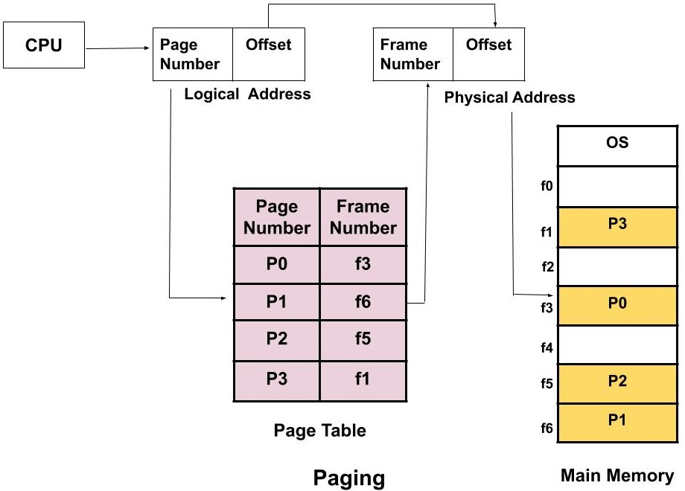
paging

Slide 32
Need of NonContiguous memory allocation
process size=4B
Page size=2B
No.of pages per process=Process size/ page size=4/2=2
page no
Byte/Word
Byte/Word
frame no
Memory size=16B
Frame Size=2B
no.of frame=16/2=8 frames
0
0
1
2
3
4
5
6
7
0 1
2 3
4 5
6 7
8 9
10 11
12 13
14 15
0 1
2 3
1
CPU
P1

Slide 33
Need of NonContiguous memory allocation
process size=4B
Page size=2B
No.of pages per process=Process size/ page size=4/2=2
page no
frame no
Memory size=16B
Frame Size=2B
no.of frame=16/2=8 frames
0
0
1
2
3
4
5
6
7
0 1
2 3
4 5
6 7
8 9
10 11
12 13
14 15
Filled
0 1
2 3
1
Filled
P1
Filled
Filled

Slide 34
Need of NonContiguous memory allocation
process size=4B
Page size=2B
No.of pages per process=Process size/ page size=4/2=2
page no
frame no
Memory size=16B
Frame Size=2B
no.of frame=16/2=8 frames
0
0
1
2
3
4
5
6
7
0 1
2 3
4 5
6 7
8 9
10 11
12 13
14 15
Filled
0 1
2 3
1
Filled
P0
P1
Filled
P1
Filled

Slide 35
Need of NonContiguous memory allocation
process size=4B
Page size=2B
No.of pages per process=Process size/ page size=4/2=2
page no
frame no
Memory size=16B
Frame Size=2B
no.of frame=16/2=8 frames
0
0
1
2
3
4
5
6
7
0 1
2 3
4 5
6 7
8 9
10 11
12 13
14 15
Filled
0 1
2 3
1
CPU
Filled
P0
P1
Filled
P1
CPU ask 3rd byte of process 1. Here we need Mapping
Filled
we need a such technique that convert addrees of 3 to addres sof 9 and give that data to cpu. This is what we called Mapping that is done by Page table
Address generated by CPU. That is not the absolute address

Slide 36
Page Table contains the frames no where that page are actually present in the Main Memory
Here every process have its own page table.
Enteries of Page table =No. of page in that process
CPU
page no
Page Table of P1
frame no
Memory size=16B
Frame Size=2B
no.of frame=16/2=8 frames
0
F2
0
1
2
3
4
5
6
7
0 1
2 3
4 5
6 7
8 9
10 11
12 13
14 15
Filled
0 1
2 3
0
1
1
Filled
P0
P1
Filled
P1
Filled

Slide 37
process size=4B
Page size=2B
No.of pages per process=Process size/ page size=4/2=2
Page Table contains the frames no where that page are actually present in the Main Memory
Here every process have its own page table.
Enteries of Page table =No. of page in that process
CPU ask 3rd byte of process 1. Here we need Mapping
3 represent with 11
CPU
page no
Page Table of P1
frame no
Memory size=16B
Frame Size=2B
no.of frame=16/2=8 frames
0
F2
F4
0
1
2
3
4
5
6
7
0 1
2 3
4 5
6 7
8 9
10 11
12 13
14 15
Filled
0 1
2 3
0
1
1
Filled
P0
P1
Filled
P1
logical Address
How to find exact location of CPU requested???
Thisproblem resolve by logical address because CPU always works with it
Filled
1 | 1
Page offset/ size of page
page no

Slide 38
process size=4B
Page size=2B
No.of pages per process=Process size/ page size=4/2=2
Page Table contains the frames no where that page are actually present in the Main Memory
Here every process have its own page table.
Enteries of Page table =No. of page in that process
CPU ask 3rd byte of process 1. Here we need Mapping
3 represent with 11
CPU
page no
Page Table of P1
frame no
Memory size=16B
Frame Size=2B
no.of frame=16/2=8 frames
0
F2
F4
0
1
2
3
4
5
6
7
0 1
2 3
4 5
6 7
8 9
10 11
12 13
14 15
Filled
0 1
2 3
0
1
1
Filled
P0
P1
Filled
Physical Address
logical Address
P1
4 bytes
1
1
Now logical addreess convert into physical address
Filled
1 | 1
3
1
page no
Page offset/ size of page
Frame no
Frame offset/ size of frame

Slide 39
process size=4B
Page size=2B
No.of pages per process=Process size/ page size=4/2=2
Page Table contains the frames no where that page are actually present in the Main Memory
Here every process have its own page table.
Enteries of Page table =No. of page in that process
CPU ask 3rd byte of process 1. Here we need Mapping
3 represent with 11
CPU
page no
Page Table of P1
frame no
Memory size=16B
Frame Size=2B
no.of frame=16/2=8 frames
0
F2
F4
0
1
2
3
4
5
6
7
0 1
2 3
4 5
6 7
8 9
10 11
12 13
14 15
Filled
0 1
2 3
0
1
1
Filled
P0
P1
Filled
Physical Address
logical Address
P1
4 bytes
1
1
Now logical addreess convert into physical address
Filled
1 | 1
3
1
page no
Page offset/ size of page
Frame no
Frame offset/ size of frame
Page offset/ size of page =Frame offset/ size of frame

Slide 40
process size=4B
Page size=2B
No.of pages per process=Process size/ page size=4/2=2
Page Table contains the frames no where that page are actually present in the Main Memory
Here every process have its own page table.
Enteries of Page table =No. of page in that process
CPU ask 3rd byte of process 1. Here we need Mapping
3 represent with 11
CPU
page no
Page Table of P1
frame no
Memory size=16B
Frame Size=2B
no.of frame=16/2=8 frames
0
F2
F4
0
1
2
3
4
5
6
7
0 1
2 3
4 5
6 7
8 9
10 11
12 13
14 15
Filled
0 1
2 3
0
1
1
Filled
P0
P1
Filled
Physical Address
logical Address 2B
P1
4 bytes
1
1
Now logical addreess convert into physical address
Filled
100 | 1
1001=9
1 | 1
3
1
page no
Page offset/ size of page
Frame no
Frame offset/ size of frame
Page offset/ size of page =Frame offset/ size of frame

Slide 41
Practice
process size=4B
Page size=2B
No.of pages per process=Process size/ page size=4/2=2
page no
frame no
Memory size=16B
Frame Size=2B
no.of frame=16/2=8 frames
0
0
1
2
3
4
5
6
7
0 1
2 3
4 5
6 7
8 9
10 11
12 13
14 15
Filled
0 1
2 3
1
CPU
Filled
P0
P1
Filled
P1
CPU ask 1st byte of process 1. Here we need Mapping
Filled
we need a such technique that convert address of 1 to address of 5 and give that data to cpu. This is what we called Mapping that is done by Page table
Address generated by CPU. That is not the absolute address

Slide 42
Disadvantage Of Paging
One major disadvantage of paging is-
It increases the effective access time due to increased number of memory accesses.
One memory access is required to get the frame number from the page table.
Another memory access is required to get the word from the page.

Slide 43
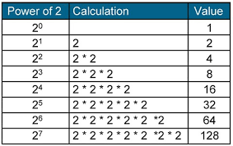
Paging Numerical
Consider a system which has LA=7 bit, PA=6 bit, Page size=8 words then calculate no of pages and no. of frames
Frame size = Page size
Page size=8 which mean 2³
Physical Address
logical Address 7 bit = 2⁷
Frame no
Frame offset/ size of page
page no
Page offset/ size of page
No. of Frame
No. of pages
if question ask No. of bit required to represent the total no of pages

Slide 44
Paging Numerical
Consider a system which has LA=7 bit, PA=6 bit, Page size=8 words then calculate no of pages and no. of frames
Frame size = Page size
Page size=8 which mean 2³
Physical Address 6 bit
logical Address 7 bit = 2⁷
 | 3
Frame no
Frame offset/ size of page
page no
Page offset/ size of page
No. of Frame
No. of pages
if question ask No. of bit required to represent the total no of pages

Slide 45
Paging Numerical
Consider a system which has LA=7 bit, PA=6 bit, Page size=8 words then calculate no of pages and no. of frames
Frame size = Page size
Page size=8 which mean 2³
Physical Address 6 bit
logical Address 7 bit = 2⁷
4 | 3
Frame no
Frame offset/ size of page
page no
Page offset/ size of page
No. of Frame
No. of pages
if question ask No. of bit required to represent the total no of pages

Slide 46
Paging Numerical
Consider a system which has LA=7 bit, PA=6 bit, Page size=8 words then calculate no of pages and no. of frames
Frame size = Page size
Physical Address 6 bit
logical Address 7 bit = 2⁷
4 | 3
Frame no
Frame offset/ size of page
page no
Page offset/ size of page
No. of Frame
No. of pages =2⁴= 16
if question ask No. of bit required to represent the total no of pages = 4

Slide 47
Paging Numerical
Consider a system which has LA=7 bit, PA=6 bit, Page size=8 words then calculate no of pages and no. of frames
Frame size = Page size
Physical Address 6 bit = 2⁶
logical Address 7 bit = 2⁷
 | 3
4 | 3
Frame no
Frame offset/ size of page
page no
Page offset/ size of page
No. of Frame
No. of pages =2⁴= 16
if question ask No. of bit required to represent the total no of pages = 4

Slide 48
Paging Numerical
Consider a system which has LA=7 bit, PA=6 bit, Page size=8 words then calculate no of pages and no. of frames
Frame size = Page size
Physical Address 6 bit = 2⁶
logical Address 7 bit = 2⁷
3 | 3
4 | 3
Frame no
Frame offset/ size of page
page no
Page offset/ size of page
No. of Frame =2³= 8
No. of pages =2⁴= 16
if question ask No. of bit required to represent the total no of frame = 3
if question ask No. of bit required to represent the total no of pages = 4
if question ask how many entries in page table of a process?
entries of page table =no of pages

Slide 49
Translation Lookaside Buffer(TLB)
Solution of Paging Problem

Slide 50
Translation Lookaside Buffer (TLB)
Translation Lookaside Buffer (TLB) is a solution that tries to reduce the effective access time.
Being a hardware, the access time of TLB is very less as compared to the main memory.
Structure
Translation Lookaside Buffer (TLB) consists of two columns
Page Number
Frame Number
Translating Logical Address into Physical Address-
In a paging scheme using TLB, The logical address generated by the CPU is translated into the physical address using following steps
Step-01:
CPU generates a logical address consisting of two parts-
Page Number
Page Offset
Step-02:
TLB is checked to see if it contains an entry for the referenced page number.
The referenced page number is compared with the TLB entries all at once.

Slide 51
Case-01: If there is a TLB hit
If TLB contains an entry for the referenced page number, a TLB hit occurs.
In this case, TLB entry is used to get the corresponding frame number for the referenced page number.
Case-02: If there is a TLB miss
If TLB does not contain an entry for the referenced page number, a TLB miss occurs.
In this case, page table is used to get the corresponding frame number for the referenced page number.
Then, TLB is updated with the page number and frame number for future references.
Step-03:
After the frame number is obtained, it is combined with the page offset to generate the physical address.
Then, physical address is used to read the required word from the main memory.

Slide 52
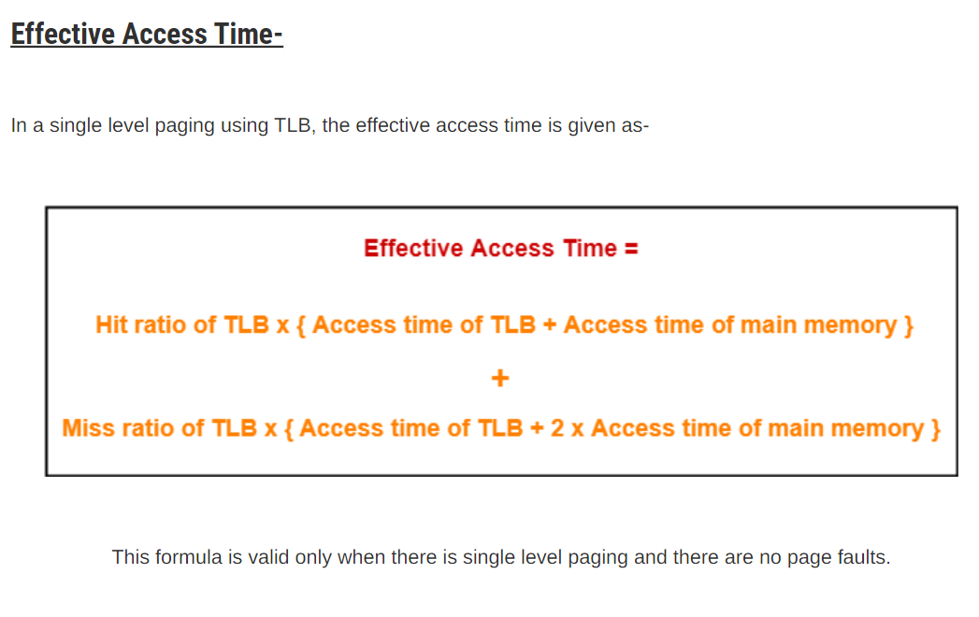

Slide 53
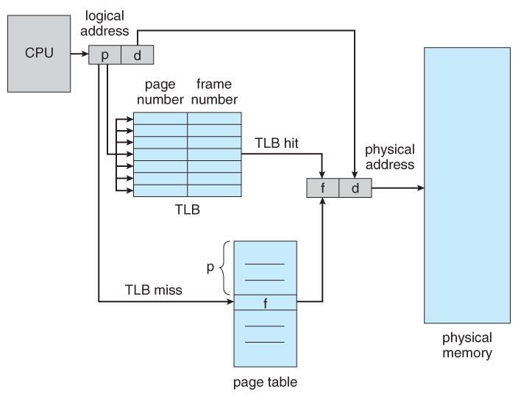
Translation Lookaside Buffer(TLB)

Slide 54
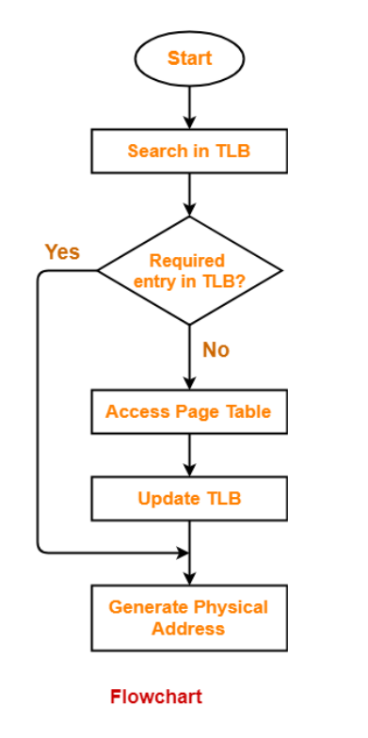

Slide 55
Numerical
A paging scheme uses a Translation Lookaside buffer (TLB). A TLB access takes 10 ns and a main memory access takes 50 ns. What is the effective access time (in ns) if the TLB hit ratio is 90% and there is no page fault?

Slide 56
Solution
Given
TLB access time = 10 ns
Main memory access time = 50 ns
TLB Hit ratio = 90% = 0.9
Calculating TLB Miss Ratio
TLB Miss ratio
= 1 – TLB Hit ratio
= 1 – 0.9
= 0.1
Calculating Effective Access Time
Substituting values in the above formula, we get-
Effective Access Time
= 0.9 x { 10 ns + 50 ns } + 0.1 x { 10 ns + 2 x 50 ns }
= 0.9 x 60 ns + 0.1 x 110 ns
= 54 ns + 11 ns
= 65 ns

Slide 57
Practice
A paging scheme uses a Translation Lookaside buffer (TLB). The effective memory access takes 160 ns and a main memory access takes 100 ns. What is the TLB access time (in ns) if the TLB hit ratio is 60% and there is no page fault?

